Slide 1
Powering the Future of Rail with Hydrogen
March 2021

Slide 2
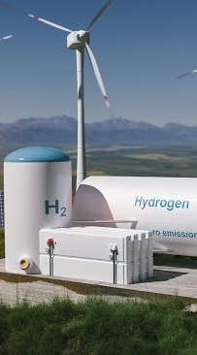





Global decarbonization is putting the focus on hydrogen
Hydrogen is a flexible energy carrier and fuel: ​
The fight against climate change and air pollution is driving the demand for fuel cell technology that converts hydrogen in clean electricity
in cars, trucks, buses, trains and ships
in industry and for critical infrastructure

Slide 3






Hydrogen is most competitive in heavy duty motive applications
Our focus is on applications where hydrogen fuel cells have a clear advantage
Buses & Coaches​
Trucks
Trains
Vessels
Fuel cell technology is needed to decarbonize the heavy duty transportation sector

Slide 4
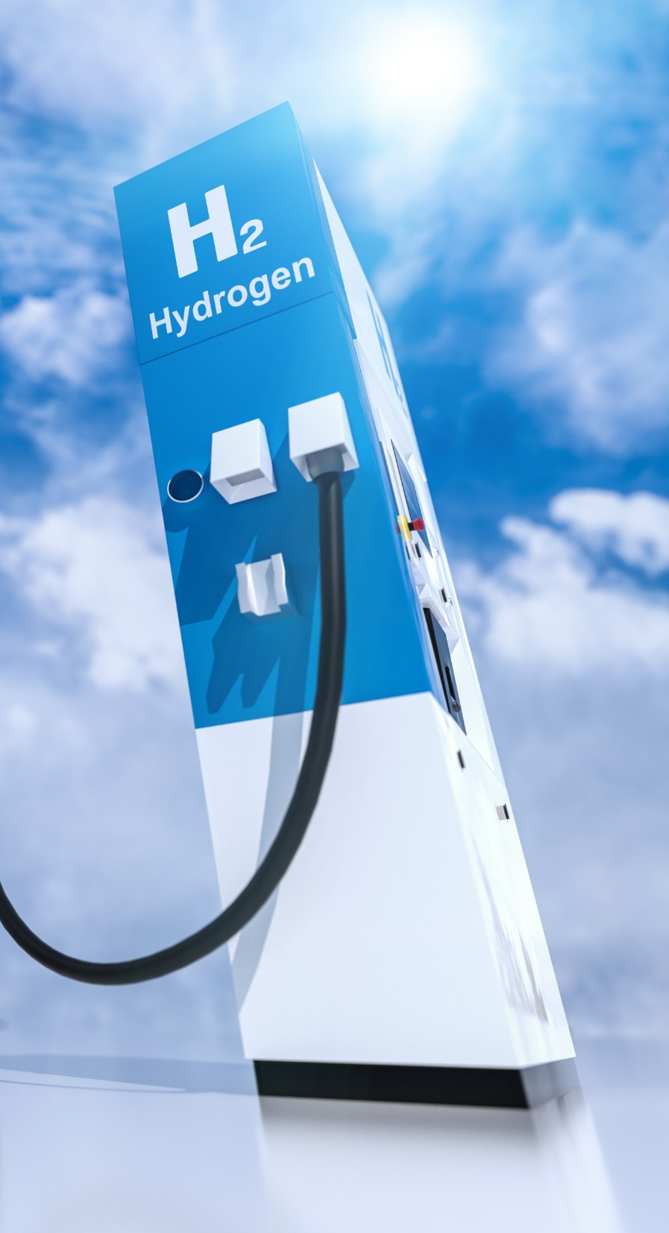




Hydrogen powered trains are poised to disrupt the rail industry
Long range and route flexibility
The environmental gains of electrification with performance and refueling time comparable to diesel
Short refueling time
Cost effective route electrification

Slide 5
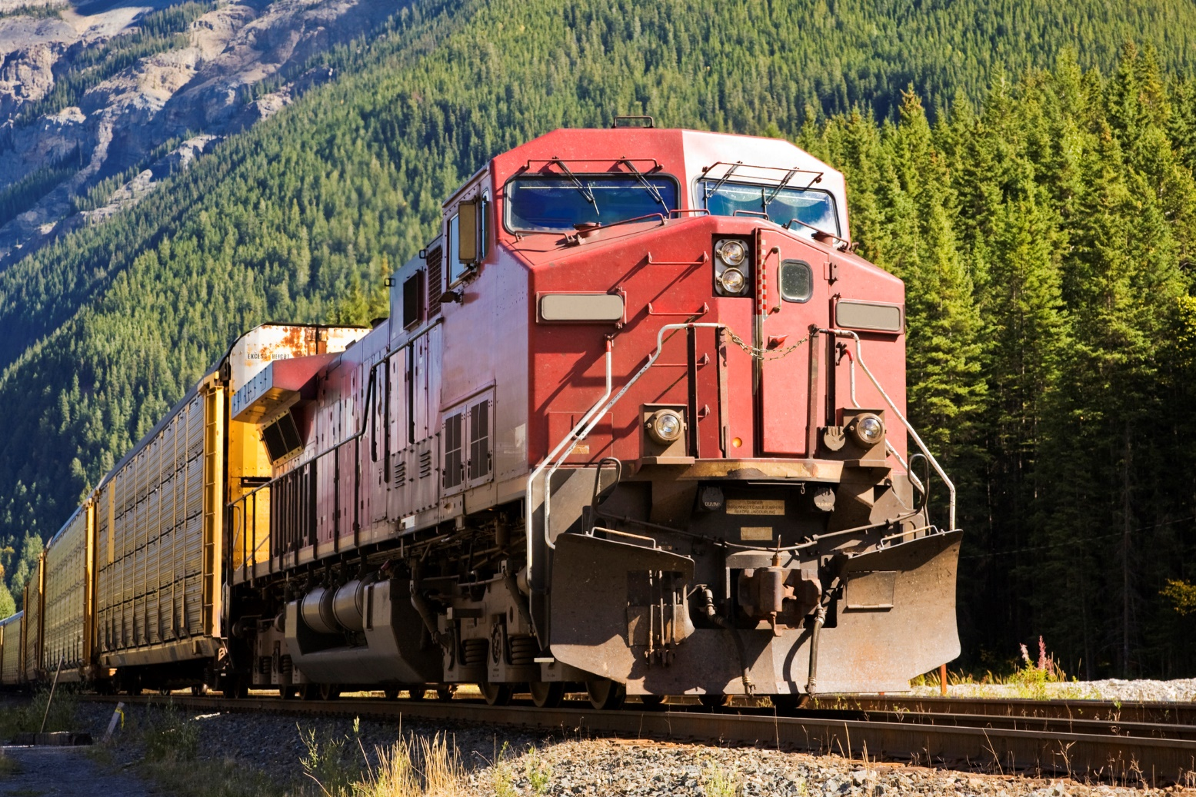
Fuel cell systems are scalable to a variety of routes and applications
Suitable applications include multiple units for regional passenger service and locomotives for shunting or freight.

Slide 6
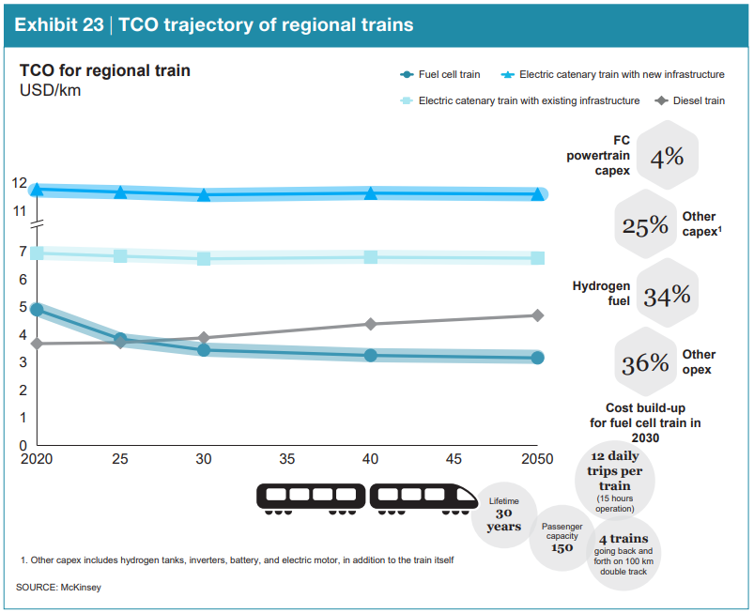
Cost effective route electrification
“The hydrogen train is already more competitive than electric catenary for a use case with relatively long distance and low frequency.”
Hydrogen Council, 2020

Slide 7
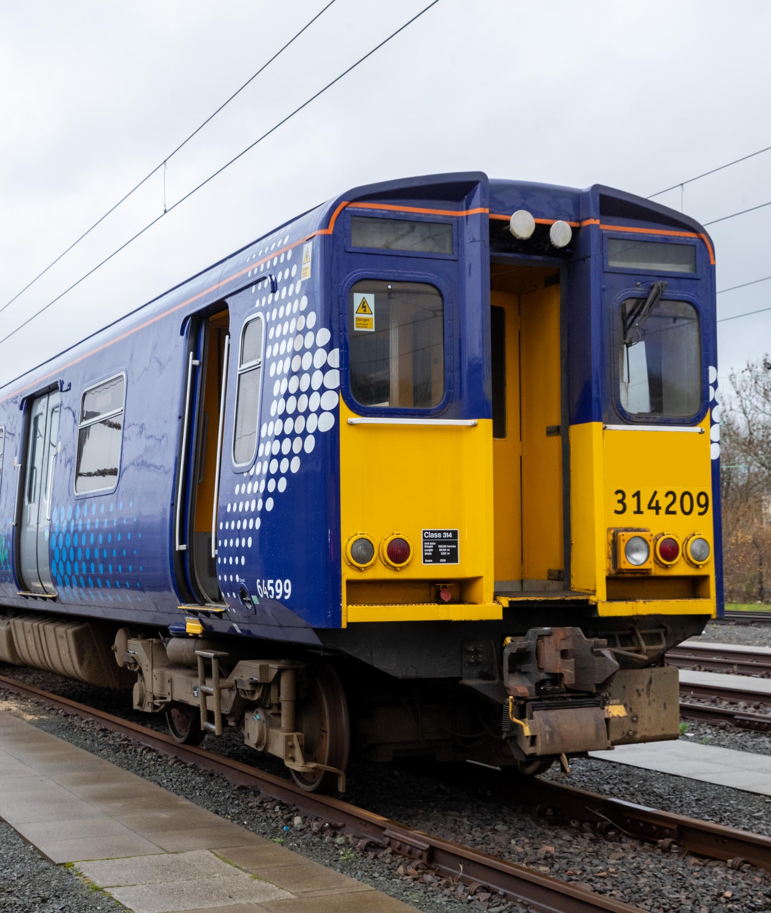
Nearly any train route served by diesel trains can be served by a hydrail train
No requirement for overhead catenary infrastructure and power substations
Enables gradual electrification (one train at the time) aligned with budget availability

Slide 8
Fuel Cell Innovators for
Over 40 Years
An introduction to Ballard and our
unique value proposition

Slide 9
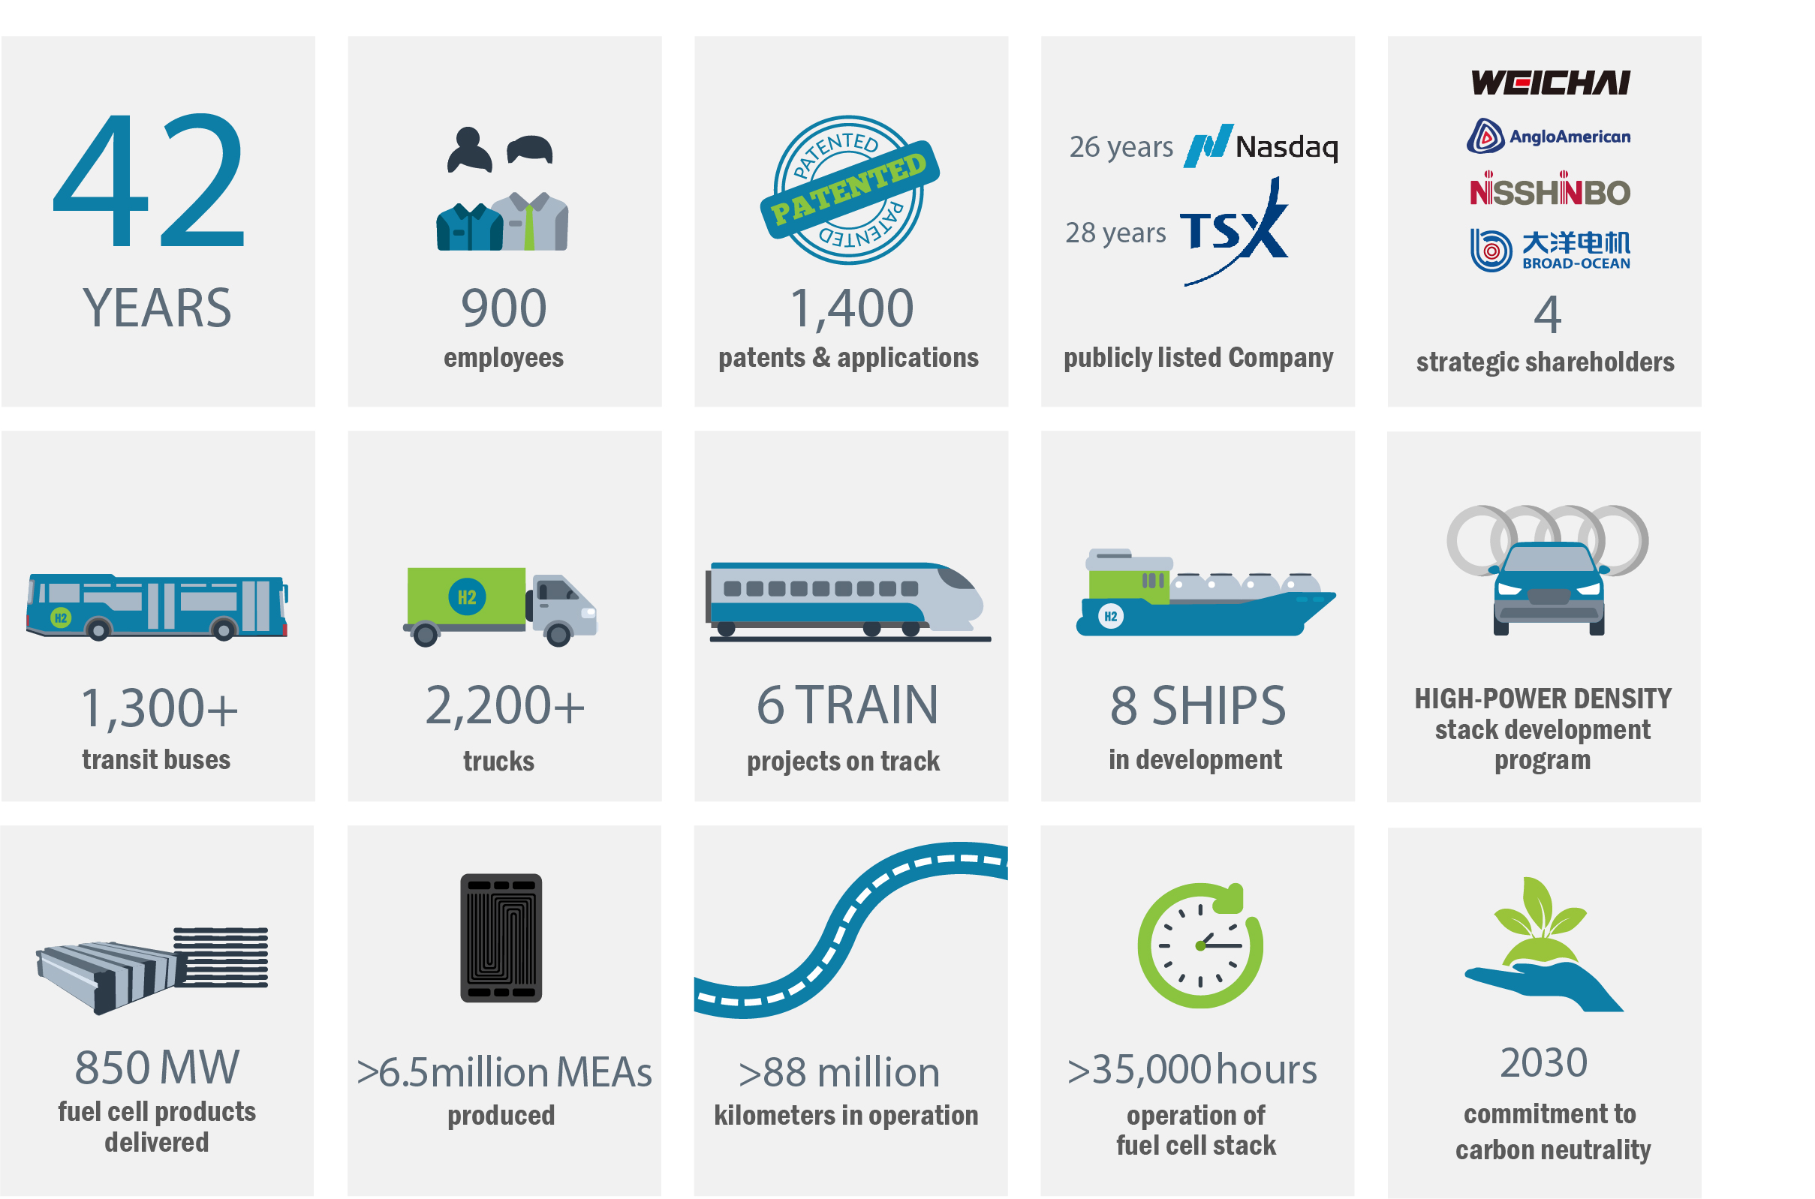
Ballard by the Numbers
Notes:
Just briefly, I’d like to bring you up to date on what Ballard has been doing lately.
Last year Ballard celebrated 40 years in business. And for the first time in our 40-year history, we can point to rapid market adoption happening, especially in medium- and heavy-duty motive applications.
Ballard fuel cells are powering over 1000 transit buses around the world and more than 2,000 delivery trucks (primarily in China). Those vehicles have traveled more than 50 million kilometers on the road – proving that fuel cell vehicles are durable, reliable and meet the performance demands of commercial fleets. We’re also expanding into other motive applications, including trains and ships.
Ballard’s strategy is focused on fuel cell commercial vehicles. And we see other industry players endorsing this strategy and repositioning to enter this space. It’s real validation of the market protentional. Together, we’re creating an industry that is changing the world of mobility to be more sustainable.

Slide 10
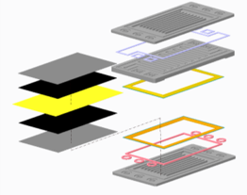
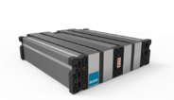
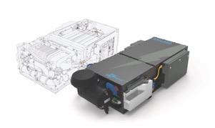
We are vertically integrated manufacturer throughout the fuel cell value chain
Ballard designs, builds and tests proprietary core technology components to produce optimized fuel cell products for each application
Unit cell components ​(MEAs, plates…)
Fuel cell stacks​
Balance of plant component integration ​
Fuel cell module & system
Notes:
Ballard is one of few PEM manufacturers that is vertically integrated. Ballard designs, builds and tests proprietary core technology components including the MEA, catalysts and bipolar plates. We draw on intellectual property from our patent portfolio, together with our extensive experience and know-how, in key areas of PEM fuel cell stack design, operation, production processes and systems integration.
At Ballard, we design fuel cell stacks from the ground up, using proprietary materials and know‐how to
trade‐off each of the product attributes. The entire system must be designed starting from the core
materials using the right mix of technology building blocks and system operating strategies.
This gives us the unique capability to produce optimized fuel cell products for each application.

Slide 11

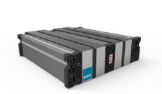
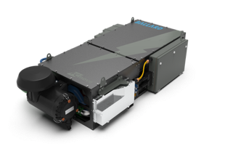





We continuously invest in our technology and product development
Unit cell components​
Fuel cell stacks
Fuel cell modules
Fuel cell vehicle integration
application engineering/ after sales service
MEA, bipolar plates​
14th generation
8th generation
Humidified and pressurized system
Freeze-start
from -25°C
IP67
protection
>30,000 hours
life time
Notes:
Our strength is in leveraging our years of experience and expertise in the design, development, manufacture and support of high performance, highly durable fuel cell modules for heavy duty applications. Today, we’re on our 14th generation of fuel cell stack products and 8th generation of fuel cell modules.
All of the learnings from the operation of these products in the real world is fed into our product design process. We continue to move the yard sticks at Ballard on stack design, with continuous improvements on power density, durability, operating parameters, freeze start capabilities, efficiency and total lifecycle costs.
And our continuing innovation efforts are focused on expanding our product roadmap to suit an even broader range of motive applications.

Slide 12
Product development focuses on meeting performance ​and lifecycle cost targets ​
Improved power density
Increased operating temperature
Simplified system integration
Reduced catalyst loading
Adaptations for truck/HD environments
Reduced
lifecycle
cost
Notes:
Ballard has been making Proton Exchange Membrane (PEM) fuel cell stacks for more than three decades. During that time we’ve commercialized several generations of products with relentless dedication to innovation. We’ve always understood that our products must work exceptionally well - in all conditions - and differently for each application. Yet they also need to be commercially viable and offer a compelling economic value proposition to the end user.
Reduced lifecycle cost is a function of many variables, that are the focus of our product development efforts. Reduction in up front product cost is achieved by simultaneously lowering catalyst loading, increasing power density, improving unit cell performance and optimizing, high volume, roll to roll MEA manufacturing processes. Increased lifetime and product refurbishment with residual value to the customer further improves total life cycle cost.
Examples:
Improved power density
Improving the power produced per unit area of the MEA, and using less material where possible. This is the most powerful cost reduction because it reduces the total number of cells in the stack.
Adaptations for heavy-duty environments
Integrating more robust balance of plant components (such as air-bearing, oil-free air compressors)
IP67 for higher durability
Higher durability leads to longer lifetime which in turn means less maintenance cost for the end user
Increased operating temperature
FCgen®-LCS can be operated at a temperature of up to 85oC (185oF), thereby reducing cooling requirements
This makes the overall system less expensive
Simplified system integration
simplified system architecture to reduce the number of parts
optimized module integration and packaging to provide maximum flexibility to vehicle integrators
Vehicle OEMs benefit from a smaller and lighter product that’s easier to integrate. Additionally, OEMs can use the different variants of the FCmove family of products for multiple vehicle platforms, reducing the amount of different stock parts they’ll have to carry.
Reduced catalyst loading
Ballard continues to actively research and achieve exciting results with advanced catalysts for better performance and durability, while supporting our goal of further reducing Pt content in our fuel cells. In our laboratory, some very promising next-generation catalyst designs are delivering up to 17x higher activity than conventional platinum catalysts.
At Ballard, we have developed a proprietary catalyst treatment/anode catalyst layer design that greatly mitigates degradation, while reducing system control requirements and hence reducing material and manufacturing costs.

Slide 13
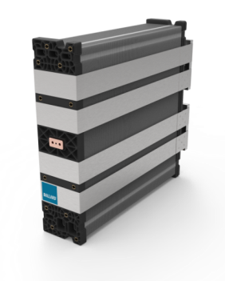
FCgen®-LCS Fuel Cell Stack
Liquid cooled fuel cell stack designed for heavy duty applications
  Design enables higher current density operation, longer life, wider operating pressure window and robust freeze start capability
  Latest Ballard heavy duty MEA improves on industry leading durability
  Increased maximum operating temperature enabling smaller OEM cooling systems
  Porting designed to increase packaging flexibility and decrease system size
  Doubling of single cell row power increasing stack and system power density
  Building on proven and demonstrated stack durability performance in the field (more than 30,000 hours in heavy duty vehicle operation)

Slide 14
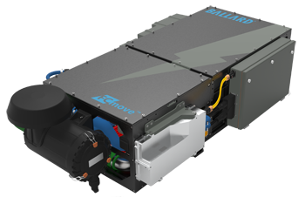







FCmove™ 8th generation heavy duty module powered by FCgen®-LCS
35%
reduction in
total life cycle cost
40%
reduction in
product volume
>30,000 hr
operating lifetime
35%
reduction in
product weight
50%
reduction in
number of components
-25°C
freeze start
capability
fuel cell stack
is recyclable

Slide 15
From road to rails
15+ years of experience in designing heavy duty fuel cell engines
Now on 8th generation of module design
Integration experience with multiple vehicle platforms (buses, trucks, trains)
Proven technology with >75 million kilometers travelled
Notes:
Our strength is in leveraging our years of experience and expertise in the design, development, manufacture and support of high performance, highly durable fuel cell modules for heavy duty applications (especially in buses). We’re bringing that value to our rail partners. They’re teaching us about the specific requirements of their applications.

Slide 16




Fuel cell system design considerations for rail
Balance of plant component choice
Modular, scalable configuration
Safety
Durability
Notes:
Fuel cell system design considerations for rail:
Balance of plant component choice to meet customers’ requirements
Reduce noise level
Meet system weight targets
Meet durability requirements (shock and vibration)
Modular, scalable configuration
100kW modules can be combined for customizable power levels
“building blocks” can be distributed through rail cars
Flexible placement to meet space constraints
Safety
Enclosure designed to prevent dust ingress (risk to electrical components)
Fire protection (especially a concern in tunnels)
Durability
Frame designed to meet shock and vibration profile of the rail duty cycle

Slide 17
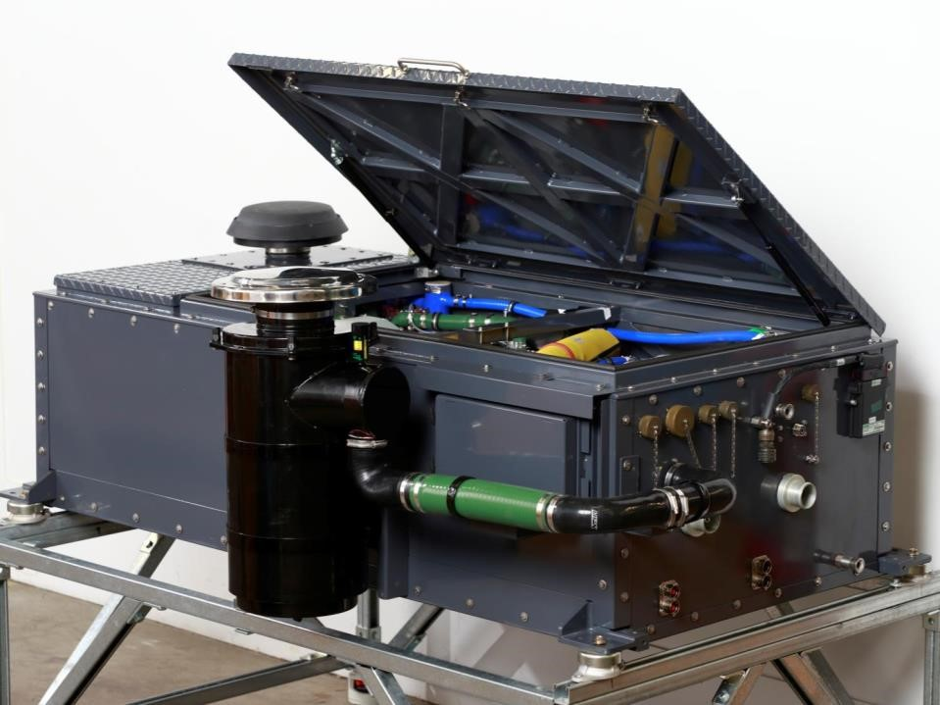
Fuel Cell Rail Module
100kW building block fuel cell power modules
Multiple units installed in flexible configuration to meet power requirements
Designed and tested to rail-specific standards
Proven fuel cell stack durability (over 30,000hrs in service)
FCveloCity®-XD (CRRC tram project)

Slide 18
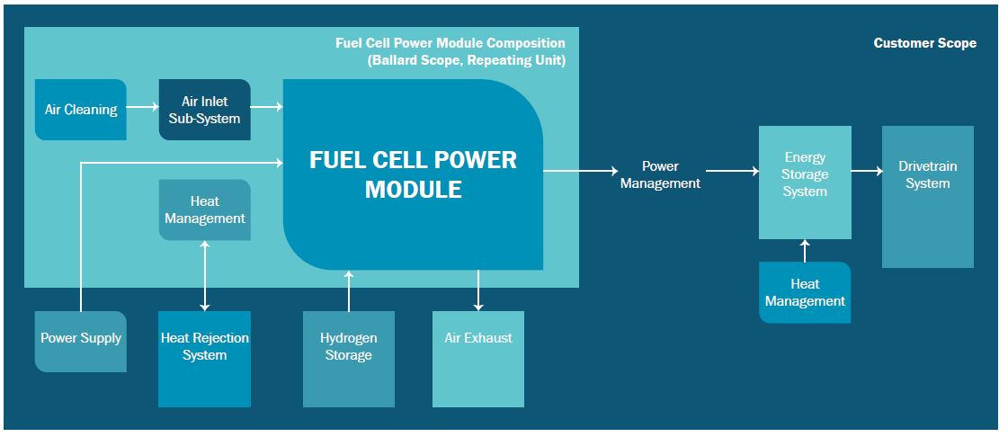
Ballard Scope of Supply

Slide 19
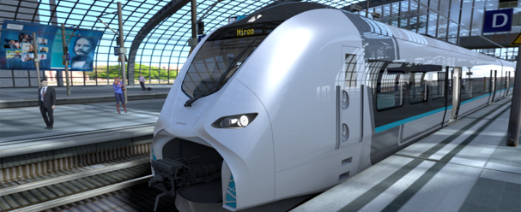
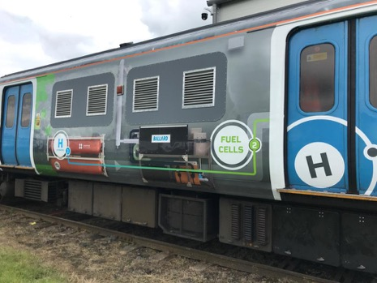
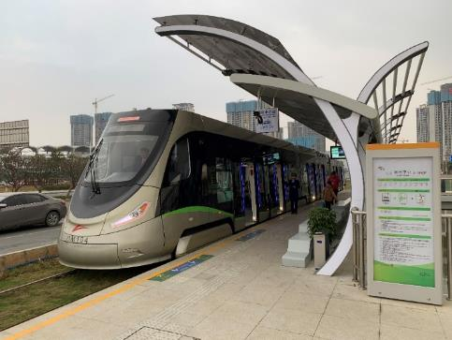
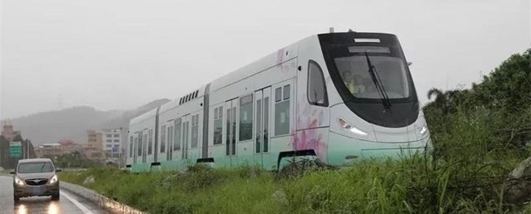
Trains powered by Ballard
Light rail systems in China
- with OEM partner CRRC (Goaming, China)
- light rail in passenger service since January 2020
Development project underway with Siemens for hydrogen EMU (MIREO)
Hydroflex retrofit project in UK with EMU – Porterbrook
Scottish Rail project UK – EMU retrofit
North America’s first hydrogen-powered line-haul freight locomotive
Sierra Northern Railway switching locomotive

Slide 20
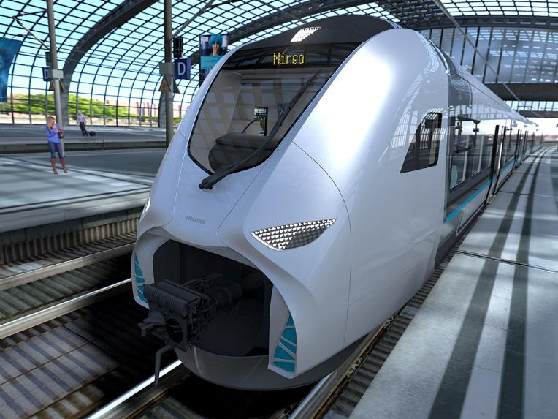
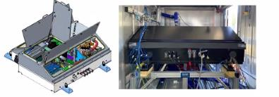
Case Study: Siemens Rail Module Development
Multi year agreement to develop a fuel cell system for Siemens Mireo® regional commuter train
Roof top mounted system that leverages Ballard’s FCmove™ module with optimized weight and footprint for maximum range
Prototype module expected to be delivered in September 2021
Achievements:
  Freeze start from -25°C
  Peak efficiency >55%
  Peak power >200 kW
  Incorporates rail standards
  Incorporates Ballard’s long life FCgen®-LCS fuel cell stack technology and advanced balance of plant
Siemens is offering Mireo® fuel cell powered trains to customers
Notes:
Slide provided by Joanna. Contact her directly for further details.

Slide 21
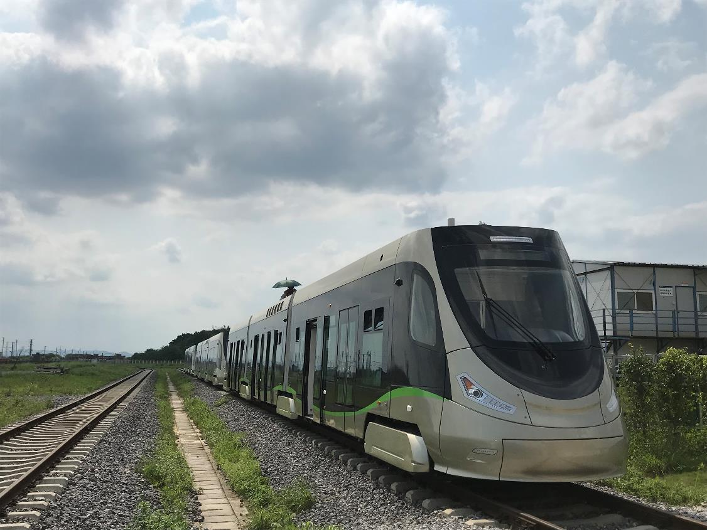
Case Study: Foshan Gaoming Modern Hydrogen Tram Line
Agreement with CRRC Sifang to develop 5 fuel cell trams
Each roof top mounted system is powered by two FCveloCity®-XD fuel cell modules
  Robust design is weight and noised optimized, with easy service access and built-in fire suppression systems
Six onboard hydrogen cylinders provide a range of 125 kilometers between refueling
Maximum speed of 70 kilometers/hour
Tram line began service in December 2019
  Has operated >7,400 hours and>73,000 kilometers as of Aug 2020
Notes:
See this case study for more details:
https://www.ballard.com/docs/default-source/motive-modules-documents/case-study-foshan-gaming-tram-final-web.pdf?sfvrsn=935ddd80_2

Slide 22
Case Study: CP Hydrogen Locomotive Program
CP will develop North America's first hydrogen-powered line-haul freight locomotive by retrofitting a formerly diesel-powered locomotive with Ballard hydrogen fuel cells
The fuel cells will work with battery technology to power the locomotive's electric traction motors
Six 200-kilowatt fuel cell modules will deliver 1.2 MW of electricity to power the locomotive
Nearly the entire freight locomotive fleet of all railway operators in North America consists of diesel-powered units, representing the industry's most significant source of greenhouse gas emissions
Notes:
See this case study for more details:
https://www.ballard.com/docs/default-source/motive-modules-documents/case-study-foshan-gaming-tram-final-web.pdf?sfvrsn=935ddd80_2

Slide 23




Addressing the cost reduction challenge:
Ballard's road map to
70% cost reduction
Strategic industrial partnerships​
will accelerate fuel cell industrialization and integration
Supply chain ​
in China will advance the fuel cell supply chain and increase access to the automotive supply chain
Ballard’s cost reduction initiatives
include process & design yield improvements, reduction of platinum, increased power density, and lower cost materials ​
Recycling/refurbishments
will increase lifecycle and improve FCEV residual value
Notes:
At Ballard, we plan to drive further fuel cell system cost reduction in four key ways:
Building strategic industrial partnerships to accelerate industrialization
There is enormous potential for cost reduction by industrializing fuel cell manufacturing. Today, fuel cells are only made in the thousands. Compared to the hundreds of thousands of batteries, and millions of diesel engines being produced, fuel cell production is very low. This is one of the reasons why we partnered in 2018 with Weichai in China, a large industrial company that makes hundreds of thousands of diesel engines every year. Part of Weichai’s role with Ballard is to help us accelerate the industrialization of our fuel cell products, so we can continue to reduce costs and deliver attractive total life cycle costs to vehicle operators.
2. Leveraging supply chain development to access diverse suppliers
At Ballard, we’re continuing to develop a fuel cell supply chain, particularly with our joint ventures in China. These partnerships will give us access to new suppliers and a very different supply chain, which will ensure we can reduce costs even further. Furthermore, the automotive supply chain is now developing low cost reliable components for fuel cell powertrains. This includes key elements of the balance of plant, which will have a significant impact on the overall system cost.
3. Focusing on internal projects to reduce our fuel cell stack costs
Internally, Ballard is continuing to improve our processes and Membrane Electrode Assembly (MEA) and fuel cell stack designs. We’re also focusing on technology innovation to increase the power density and lower the precious metal catalyst loading of our fuel cell stacks. Three key improvements we’ve made in these areas are:
Choosing lower-cost carbon instead of metal for our bipolar plates (learn more in this blog)
Automating our production lines to reduce labor costs and improve production capacity
Implementing process design and throughput scale-up to improve production yields and support future growth
4. Refining our recycling and refurbishing processes
Our ability to recycle catalysts, re-use bipolar plates, and refurbish fuel cells is a real advantage for both Ballard and our customers. Doing so lowers the total lifecycle costs of our products, reduces environmental impact, and generates residual value for the vehicle. As a result, the economics improve and it demonstrates that fuel cell technology is becoming bankable for vehicle financing.

Slide 24
Thank you
Please contact Ballard for more information
www.ballard.com
Power to Change the World®

